Slide 1
IBM University Engagement Project Submission
“Exploring the Power of Agentic AI with IBM Granite and LangFlow”

Slide 2

Project Title - Intelligent Classification of Rural Infrastructure Projects
Domain of Project – Rural Development
Student Name | Recent Passport photo | Email ID | Mobile number [WhatsApp]
Ruthika Ponugoti |  | ponugotiruthika19@gmail.com | 9121574818

Slide 3
Problem Statement –
Problem Statement : - Intelligent Classification of Rural Infrastructure Projects.
The Challenge
Manually classifying PMGSY road and bridge construction projects into different government schemes is time-consuming and error-prone. This project aims to use Machine Learning to automatically identify the correct PMGSY scheme based on the project's physical and financial details.
The Objective
The main objective of this project is to develop a Machine Learning-based system that automatically classifies road and bridge construction projects under the correct Pradhan Mantri Gram Sadak Yojana (PMGSY) scheme. It aims to reduce manual work, improve classification accuracy, and support better monitoring of rural infrastructure development.
The specific objectives are:
1 . To automate the classification of PMGSY road and bridge construction projects using Machine Learning.
2 . To identify the correct government scheme based on the physical and financial characteristics of each project.
3 . To reduce the time, effort, and errors involved in manual project classification.
4 . To collect and preprocess project data from the AI Kosh PMGSY dataset.
5 . To analyze important project details such as road length, project cost, expenditure, population, terrain, and construction year.
6 . To develop and train a Random Forest classification model for predicting the appropriate PMGSY scheme.
7 . To classify projects into different schemes such as PMGSY-I, PMGSY-II, PMGSY-III, RCPLWEA, and MNREGA.
8 . To evaluate the model using performance metrics such as accuracy, precision, recall, and F1-score.
9 .To develop a user-friendly interface using Streamlit for exploring project data and predicting schemes.
10. To deploy the trained Machine Learning model using IBM Watson Machine Learning on IBM Cloud Lite services.

Slide 4
Proposed System
The proposed solution automates the classification of PMGSY road and bridge construction projects into their correct government scheme using supervised Machine Learning. Instead of manual tagging, a trained Random Forest Classifier analyses each project's attributes and instantly predicts the appropriate scheme with a confidence score.
Each project record is described using 13 input features across three categories. Physical features include road length (in km), bridge length (in metres), terrain type, and surface type. Financial features capture the DPR cost, revised cost, and total expenditure (all in Lakh ₹). Administrative features cover the state name, sanction year, project type (Road or Bridge), number of connected habitations, and habitation population. Categorical features are label-encoded and numeric features are standardised using Standard Scaler before model training.
A Random Forest Classifier with 300 decision trees is used as the core model. It is trained with balanced class weights to handle any imbalance between scheme categories. The dataset is split into 80% training and 20% testing using stratified sampling to preserve class distribution. The model is implemented using scikit-learn and persisted using joblib for reuse across prediction and deployment.
For every project record submitted, the model predicts one of five PMGSY scheme labels — PMGSY-I, PMGSY-II, RCPLWEA, PMGSY-III, or MNREGA — along with the confidence probability for each class. This eliminates manual classification errors and scales easily to thousands of project records through batch prediction. The trained model can optionally be deployed to IBM Watson Machine Learning as a persistent online scoring endpoint. Once deployed, any system can classify project records in real time by calling the REST API — making the solution ready for integration with existing government MIS platforms without any infrastructure cost.

Slide 5
Technologies Used:
IBM Cloud – Provides the cloud infrastructure to access and manage IBM services required for the PMGSY Scheme Classifier.
IBM Watson Machine Learning – Used to deploy the trained Random Forest model in the cloud and generate predictions for new PMGSY road and bridge projects.
IBM Cloud API Key – Used for authentication to securely access IBM Cloud services.
Watson Machine Learning API Key – Used to establish a secure connection between the Python application and IBM Watson Machine Learning for model deployment and prediction.
IBM Watson Machine Learning Deployment Space – Used to manage the deployed machine learning model and its deployment resources.

Slide 6
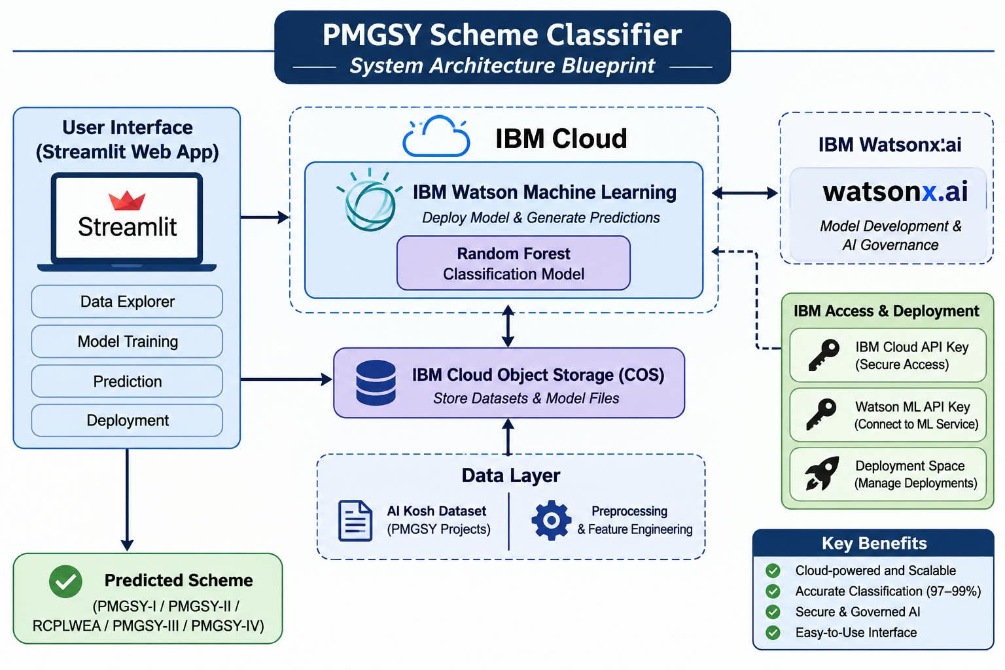
Architecture blueprint

Slide 7

Role of Agentic AI in the Solution
Agentic AI plays an important role in making the PMGSY Scheme Classifier more intelligent and automated. It acts as an intelligent assistant that analyses road and bridge project details and identifies the important information required for scheme classification.
It helps in automated data analysis by examining project details, identifying relevant features, and checking for missing or inconsistent information before classification.
Agentic AI supports intelligent decision-making by working with the trained Random Forest machine learning model to identify the appropriate government scheme, such as PMGSY-I, PMGSY-II, PMGSY-III, PMGSY-IV, or RCPLWEA.
It also helps in automated prediction and result explanation by obtaining predictions from the machine learning model and explaining why a particular scheme was selected based on the project features.
Furthermore, Agentic AI can reduce manual work by assisting government officials in analysing project records, reviewing predictions, and making better classification decisions.

Slide 8
Novelty and Uniqueness
The proposed PMGSY Scheme Classif ier stands out by combining Machine Learning, automated scheme classification, and IBM Cloud integration into a single intelligent system.
Automated Scheme Classification –Automatically classifies road and bridge projects into the appropriate PMGSY schemes instead of depending on manual identification.
Multi-Scheme Identification – Supports classification across PMGSY-I, PMGSY-II, PMGSY-III, PMGSY-IV, and RCPLWEA within a single application.
Random Forest-Based Intelligence – Uses the Random Forest algorithm to analyse multiple project features and identify the most suitable scheme.
Feature-Based Decision Making – Analyses project details such as road length, location, connectivity, project type, and other relevant attributes to make predictions.
IBM Cloud Integration – Uses IBM Watson Machine Learning to deploy the trained model and provide cloud-based prediction capabilities.
Interactive Data Exploration – Provides a Streamlit interface to explore datasets, understand project information, and perform model training and predictions.
Fast and Consistent Predictions – Reduces manual classification effort and provides quick, consistent results for new project records.
Scalable and Expandable System – Supports future integration of additional datasets, government infrastructure projects, and advanced AI capabilities.

Slide 9
Git Hub Link
https://github.com/ponugotiruthika-cloud/pmgsy-scheme-classifier

Slide 10
Future Scope
Integration of Agentic AI and Advanced Automation:
In the future, Agentic AI can be integrated to analyse project details,validate input data, identify missing information, and explain the predicted PMGSY scheme. It can also assist government officials in making better classification decisions and reducing manual effort.
2. Real-Time Data Integration and Scalability
The system can be enhanced by integrating real-time government datasets and additional infrastructure project records. It can support larger datasets, improve prediction performance, and expand to other government road development schemes through cloud-based deployment using IBM Watson Machine Learning.

Slide 11
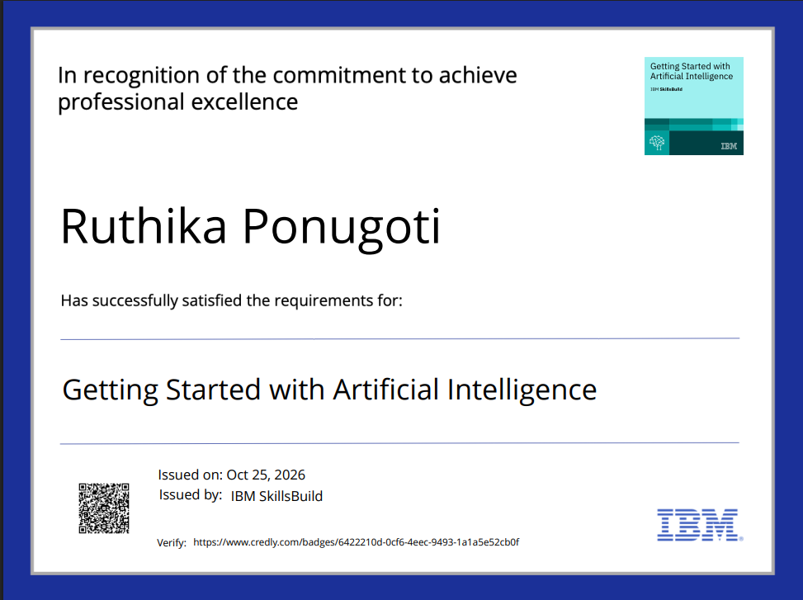
Certificates Earned:

Slide 12
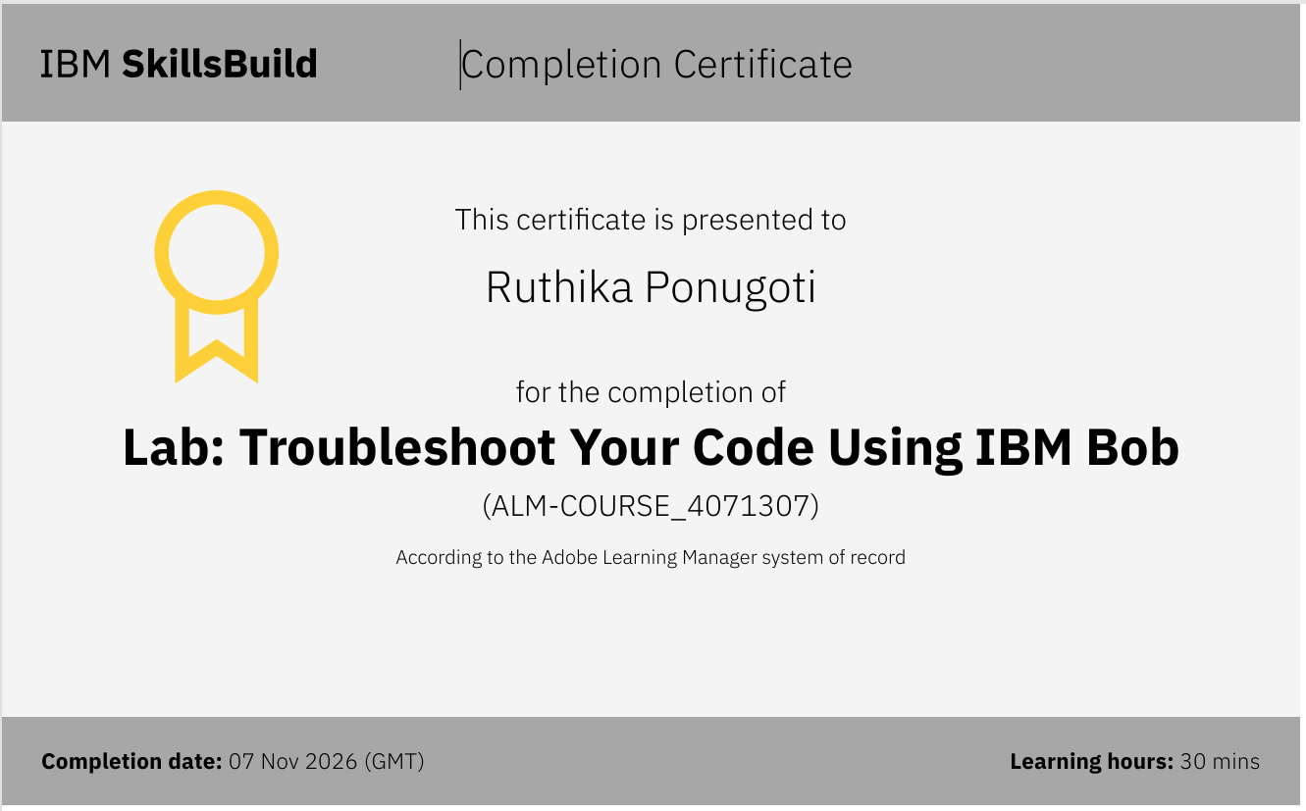
Certificates Earned:

Slide 13
Thank You!

